Slide 1
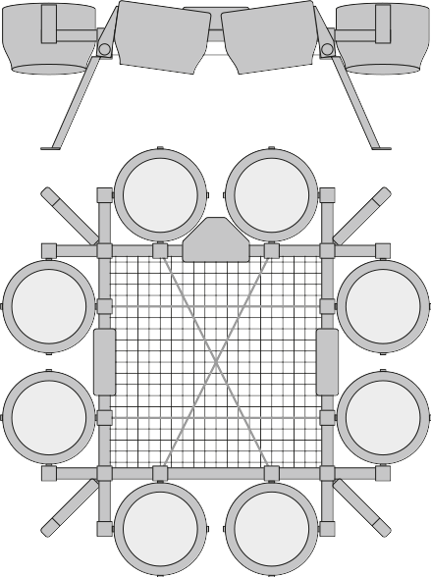
rev 1.6
By Valentin BERTRAND
2019/08/21
Wohler Mark V - Delivery Drone
Technical Specs :
Frame was designed to fly with 8 turbines Athena V1.64
Power source - two batteries Li-Po, 6S, 22Ah, 25C, 2500g each.
Autopilot - Pixhawk2 Cube
Payload up to 10 kg, 550x540x220mm (cabin luggage size)
Size of the drone - 116x117x43cm
Mass of the frame only - 2,3kg
Frame with wiring and avionics - 3,4kg
Batteries - 5,1kg
Turbines - 1,15kg each, 9,2kg - eight turbines.
RTF mass - 17,7kg
Safe thrust of Athena 1.64 turbine - 30N (20V on ESC, 40A)
Total thrust - up to 300N on a full battery

Slide 2
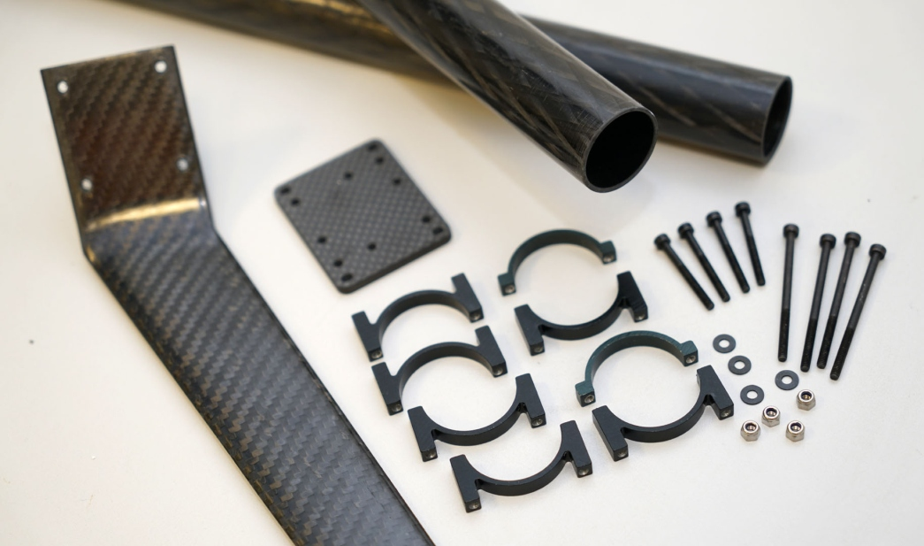
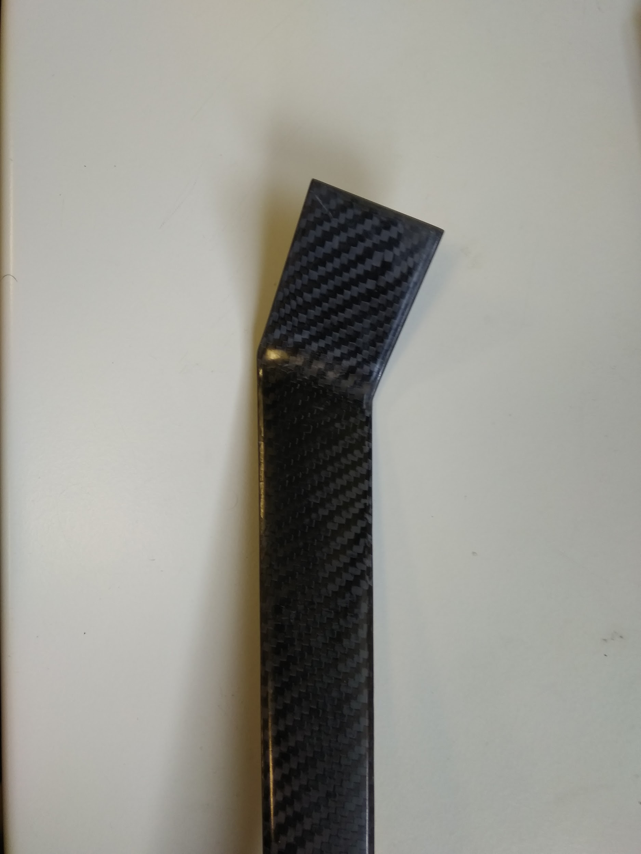
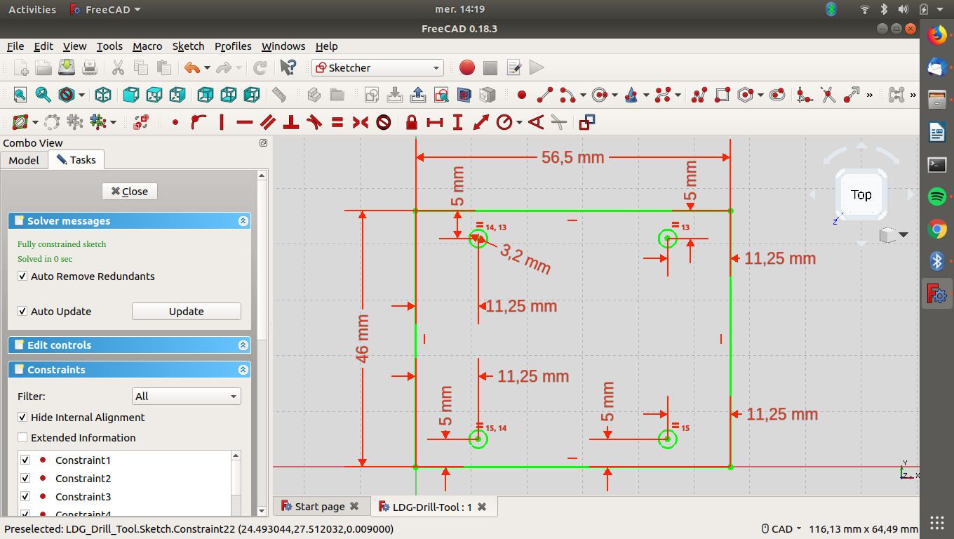
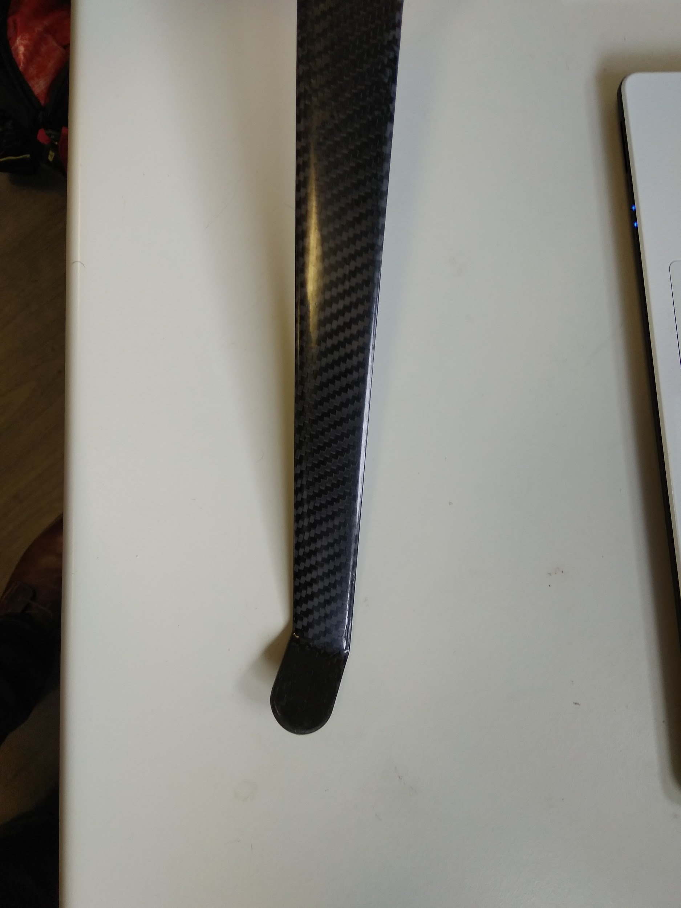
I) Assembling LDG (1/2)
Pieces
2
1 | Carbon LDG
2 | Small Carbon Plate
3 | Aluminum Spacers
4 | 4 Screws M3x25, 4 M3x50, 4 M3nuts, 1 M4x16 , 1 M4nuts
1
3
4
Step 1 : Drill LDG with 3mm drill bit
Rq : you can use the 3D printed tool (LDG-Drill-Tool.stl)
4mm hole for Caoutchouc pad

Slide 3
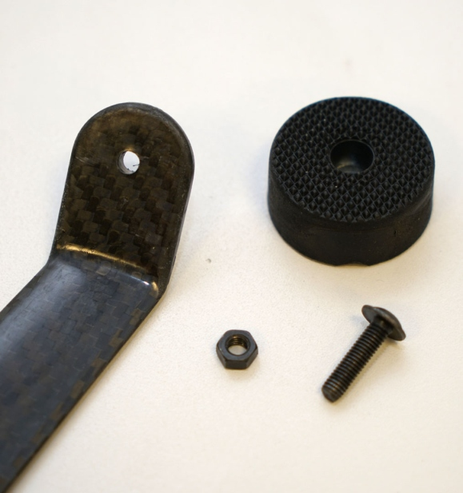
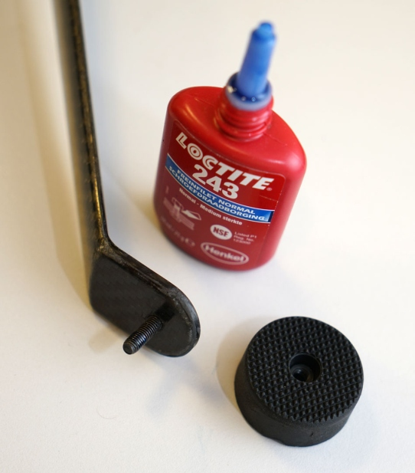
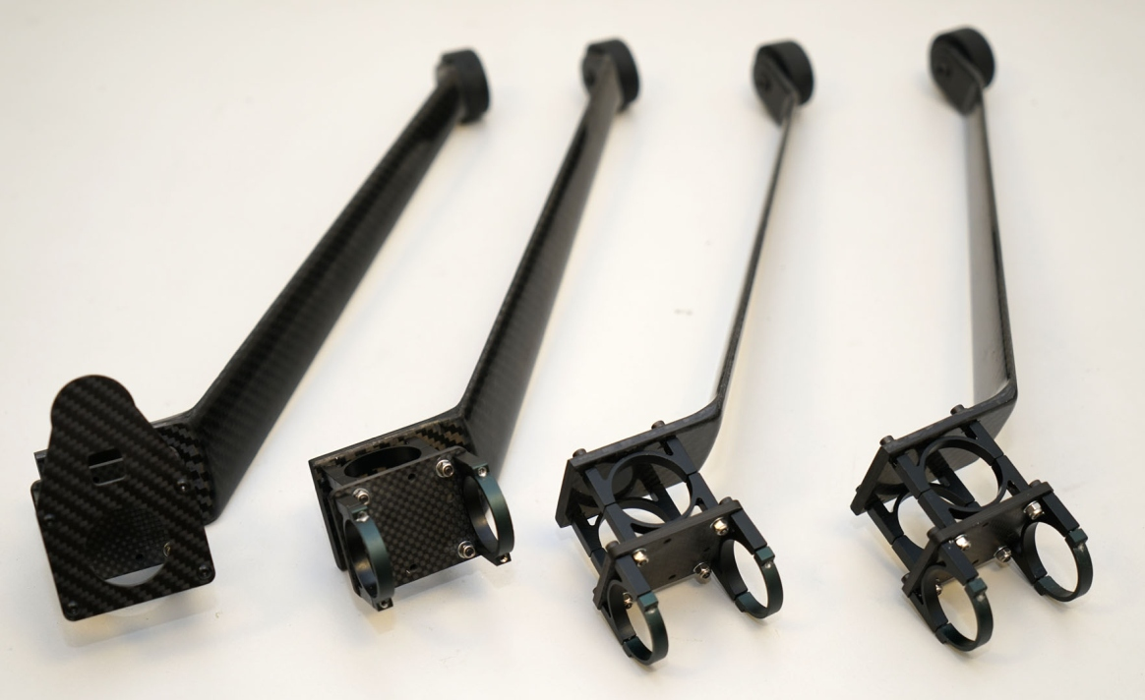
I) Assembling LDG (2/2)
Step 2 : Glue M4 nut in the caoutchouc pad & screw caoutchouc pad on LDG
Step 3 : Assemble Alu spacers with M3 screws (x4) & Carbon plate

Slide 4
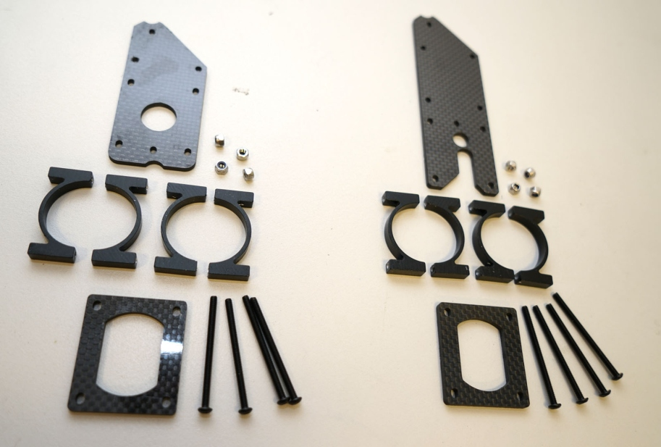
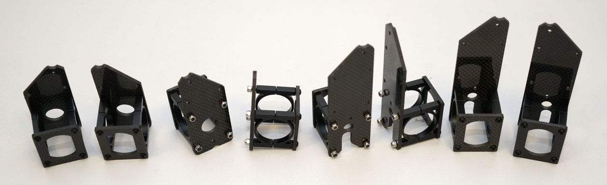
II ) Assembling Turbine Holder 1
2
3
Pieces :
1 | Small Carbon Plate (x2)
2 | Medium Carbon Plate
3 | Big Carbon Plate
4 | Aluminum spacers (x4)
5 | M3x45 screws (x8)
6 | M3 nuts (x8)
6
4
1
5
Step 1 : Assemble Alu spacers with M3 screws & Carbon plates

Slide 5
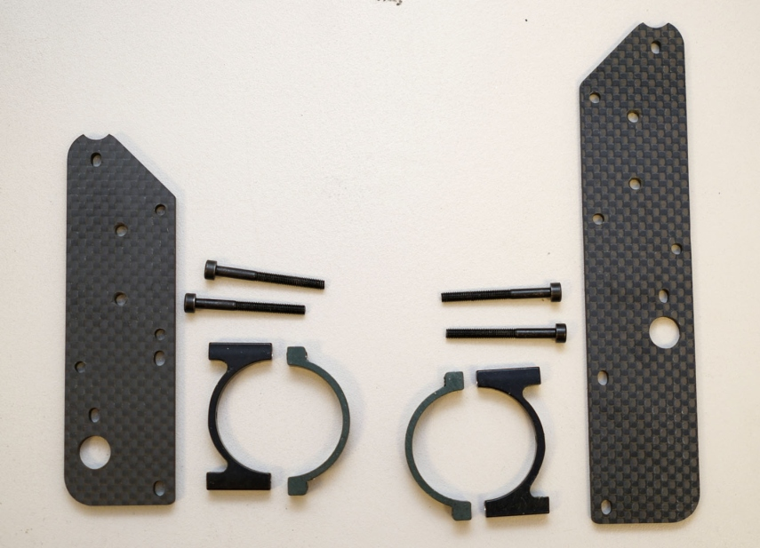
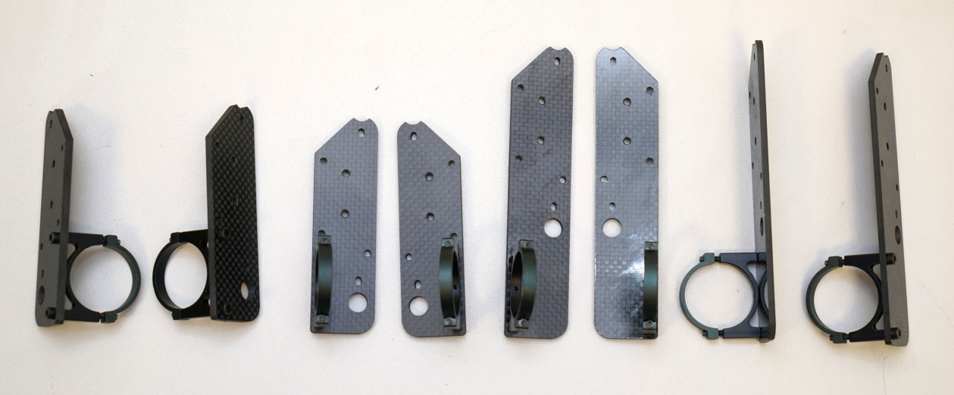
III ) Assembling Turbine Holder 2
Pieces :
1 | Small carbon plate
2 | Big carbon plate
3 | Alu spacers
4 | M3x30 screws
4
3
1
2
Step 1 : Assemble Alu spacers with M3 screws & Carbon plates

Slide 6
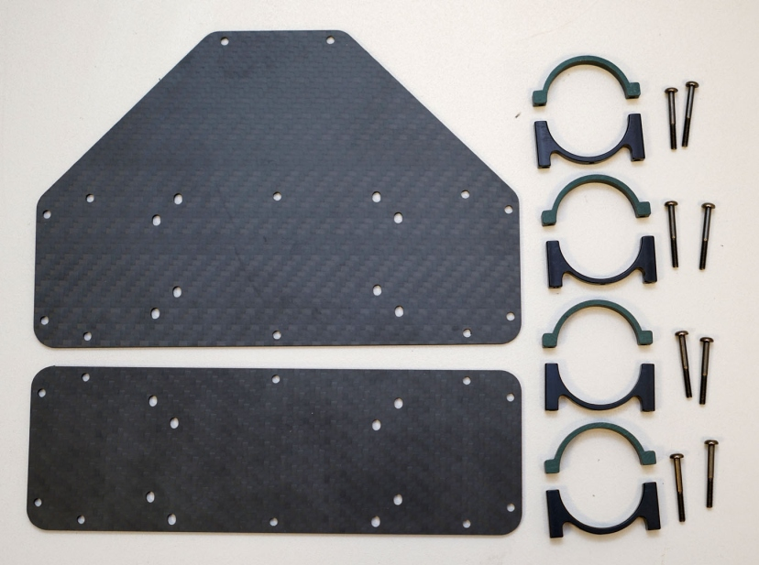
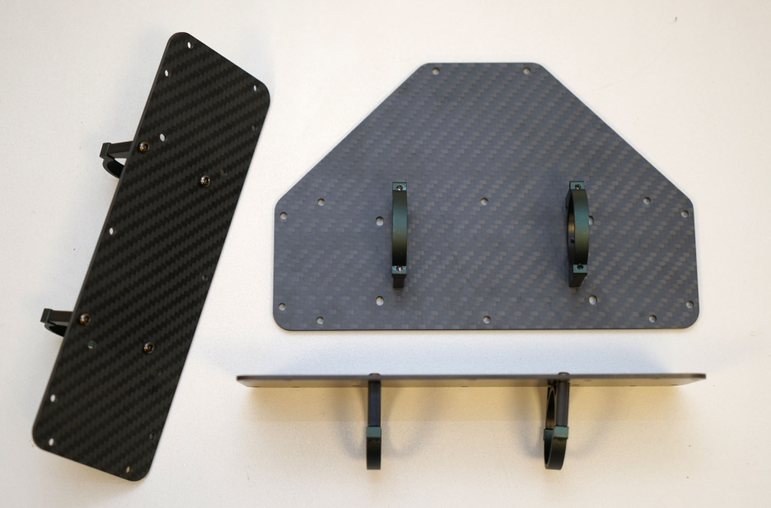
IV ) Assembling PX & Battery Holder
1
Pieces :
1 | PX carbon plate
2 | Battery carbon plate
3 | Alu spacers
4 | M3x25 screws
3
4
2
Step 1 : Assemble Alu spacers with M3 screws & Carbon plates

Slide 7
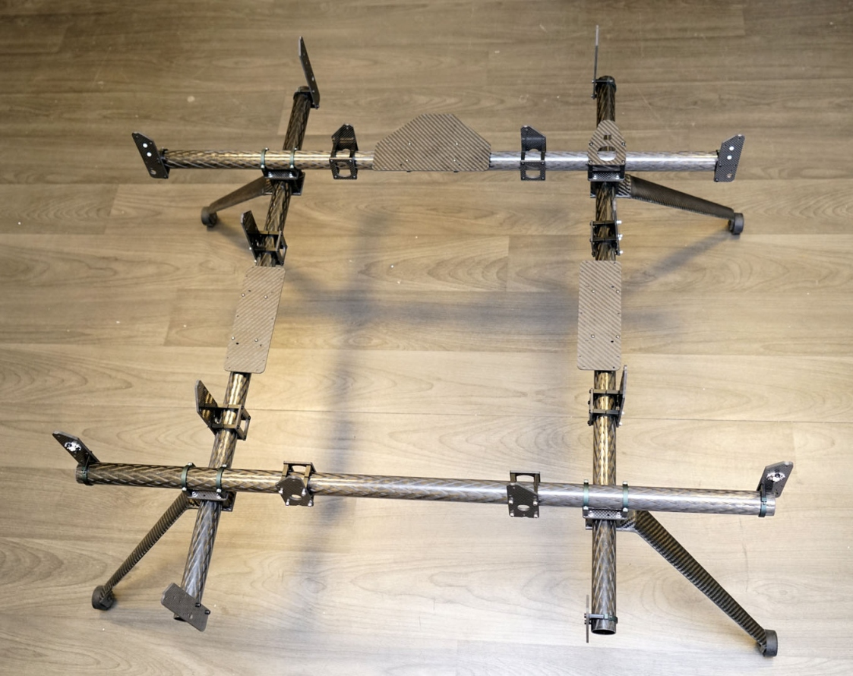
V ) Assembling Frame
Step 1 : Assemble Pieces previously mounted (I to IV) on carbon tubes
Symmetrical design
Attach the turbine to set proper distance between mounts.

Slide 8
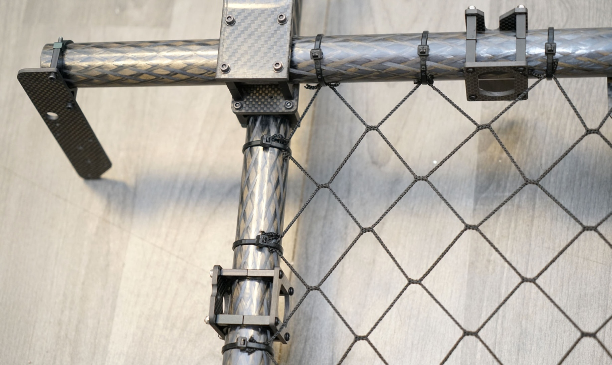
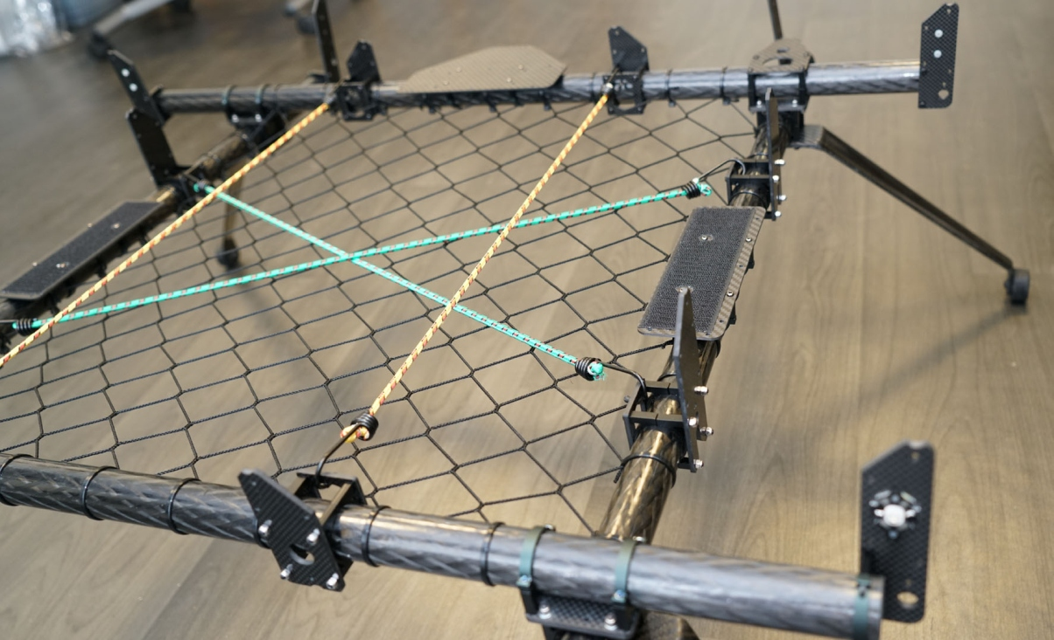
VI ) Mounting Nylon mesh
Pieces :
Nylon net 650*650 twine #18 mesh 30 | Zip ties 18kgf

Slide 9
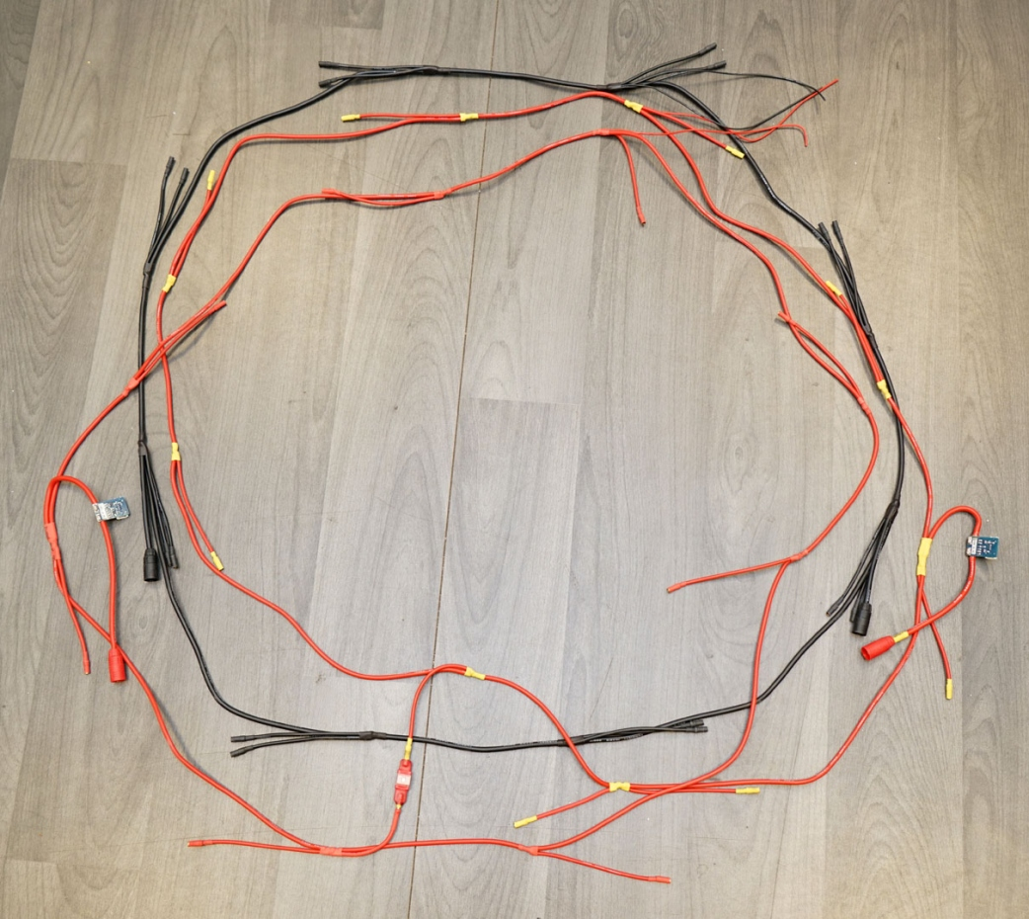
VII ) Wiring (1/3)
Power harness :
Perimeter : 240cm
Black 10AWG
Red 12AWG
Fuse
Motor Connectors
BEFORE WIRING SEE FULL WIRING DIAGRAM :
In Dropbox : NPC-A024-A-B-Mark-V/Eng_Wohler-b-Mark-V-X8_…ineering
/WB5-WiringDiagram/Wohler-B-MarkV-WiringDiagram-rev1.0-20190821-vb.pptx

Slide 10
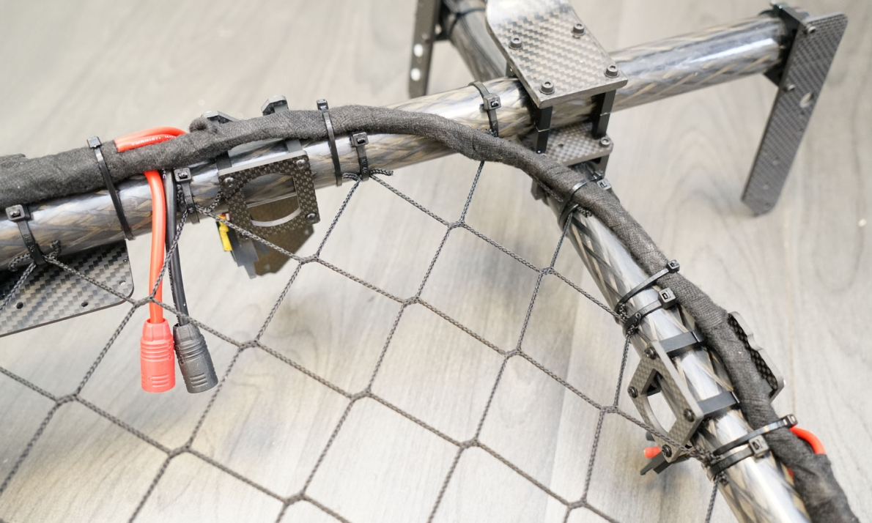
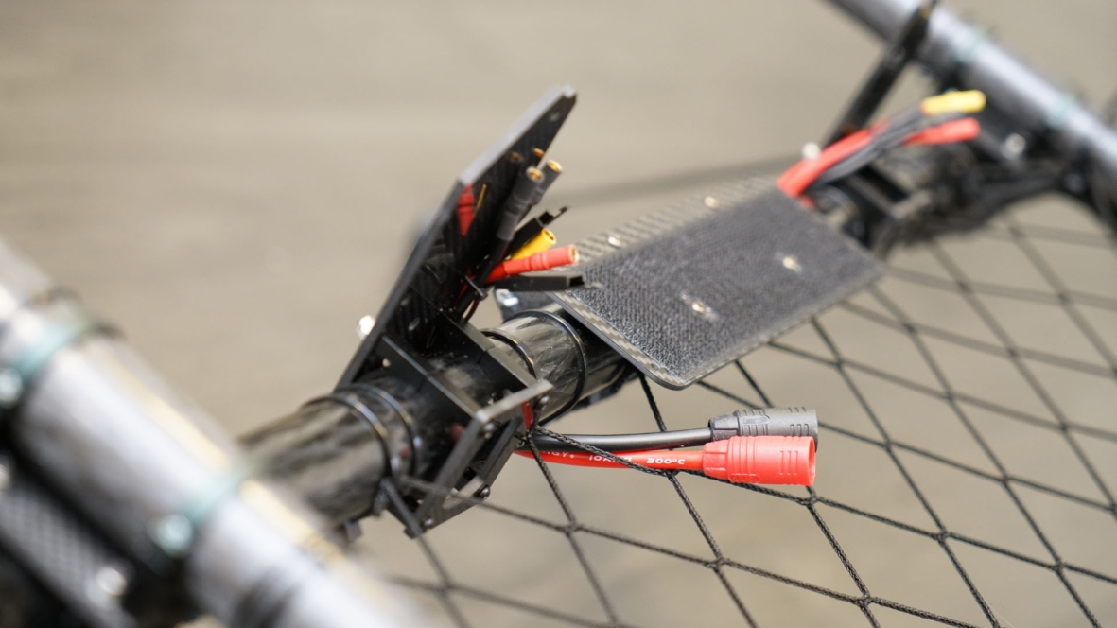
VII ) Wiring (2/3)

Slide 11
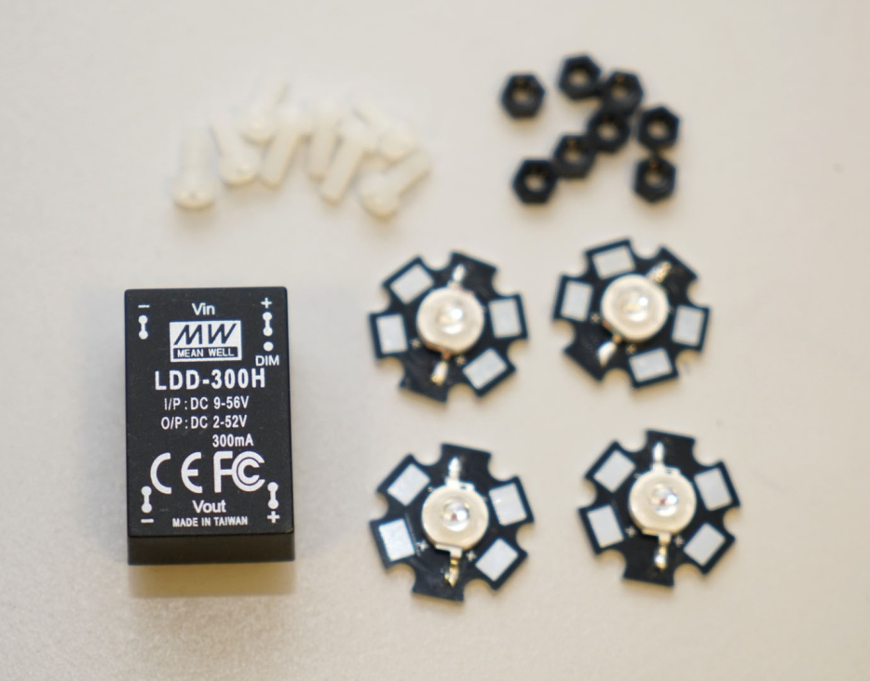
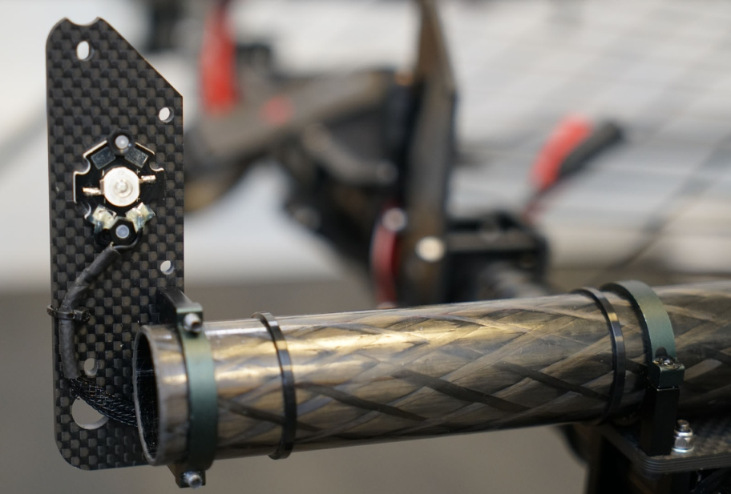
VII ) Wiring (3/3)
Assembling LED :
Colors :
Front : Green
Back : Red
(DJI style)

Slide 12
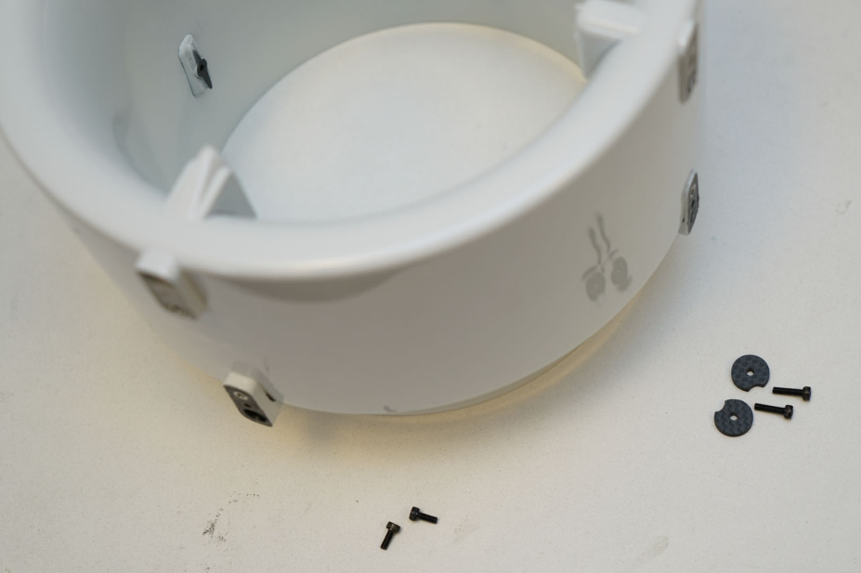
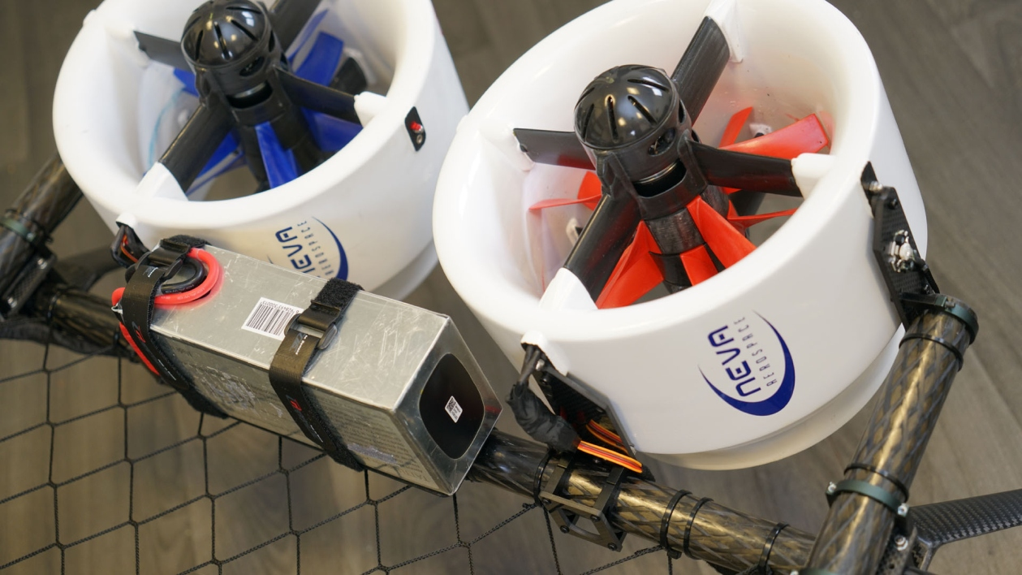
VIII ) Mounting Turbines
M3x8 & M3x12 screws

Slide 13
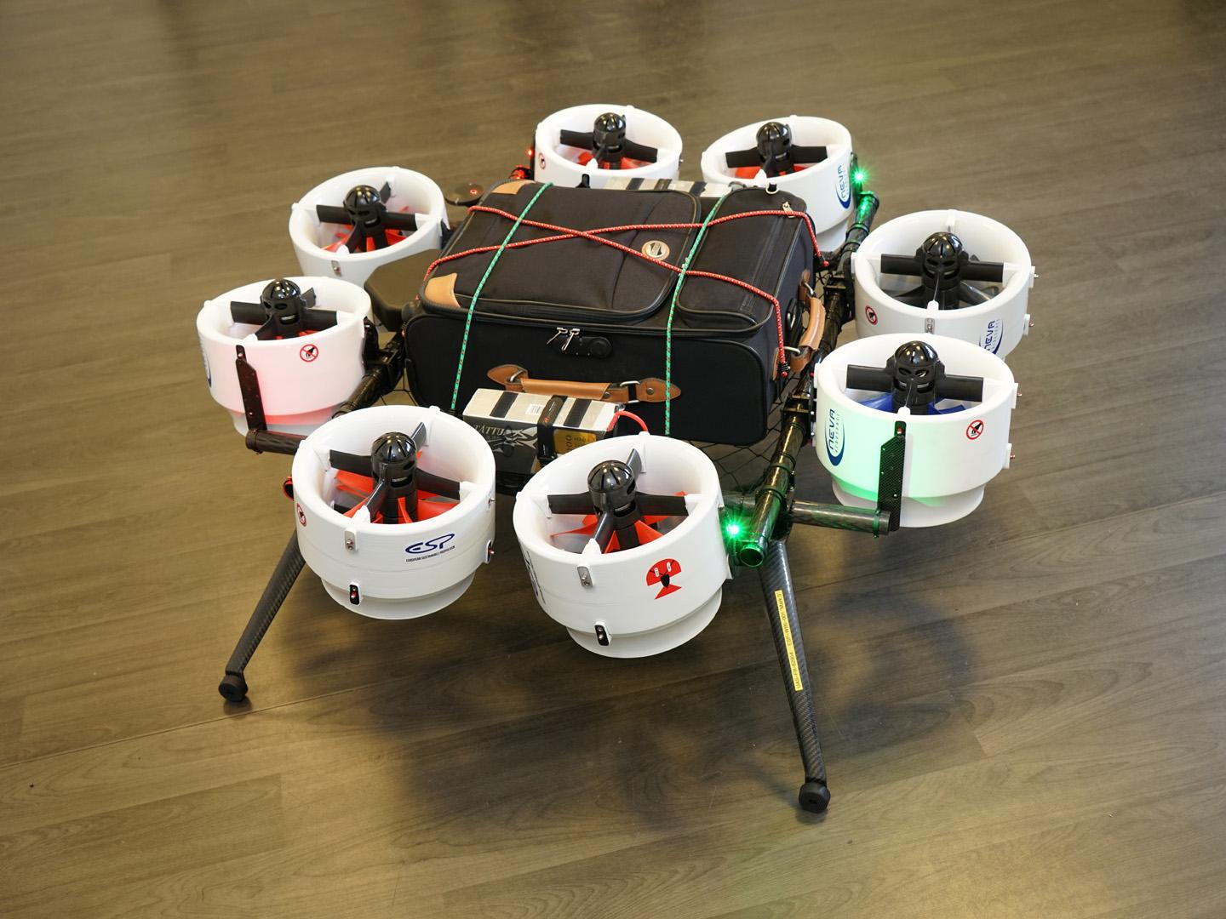
Final Result

